Slide 1
K-12 Fiscal Update
California Association of Suburban School Districts
March 1, 2024

Slide 2
Governor’s Budget

Slide 3
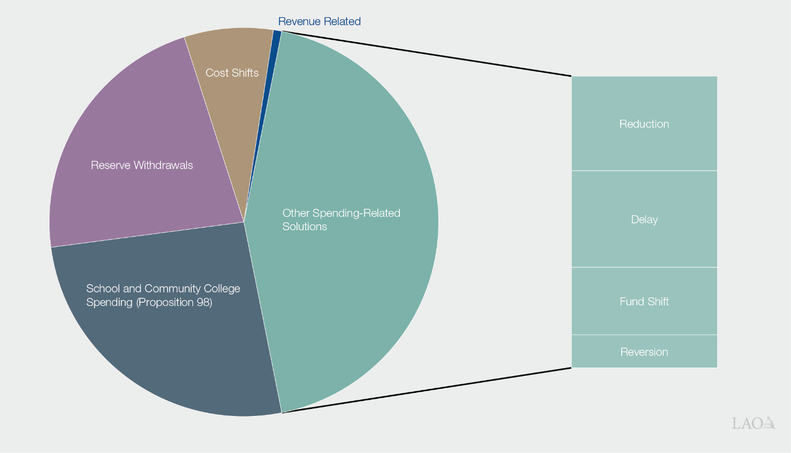
Governor’s Plan for Addressing Large Budget Shortfall
Total Solutions = $58 Billion

Slide 4
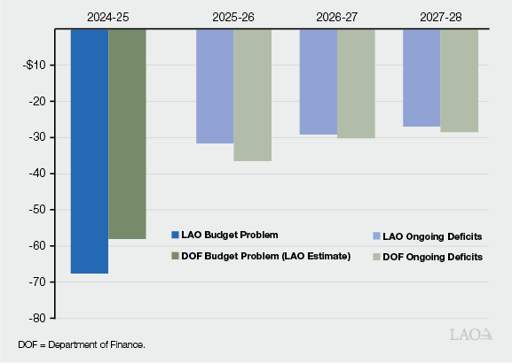
Significant Operating Deficits Anticipated Over Next Several Years
In Billions

Slide 5
Assessing the Governor’s Budget
Revenue Estimates Seem Too Optimistic
Reserve Withdrawals Generally Reasonable
Despite Spending-Related Solutions, Budget Appears Unsustainable in Future Years
Budget has a number of proposals delaying spending.
Delayed spending adds to future deficits and is likely unaffordable.

Slide 6
Revenue Assessment

Slide 7
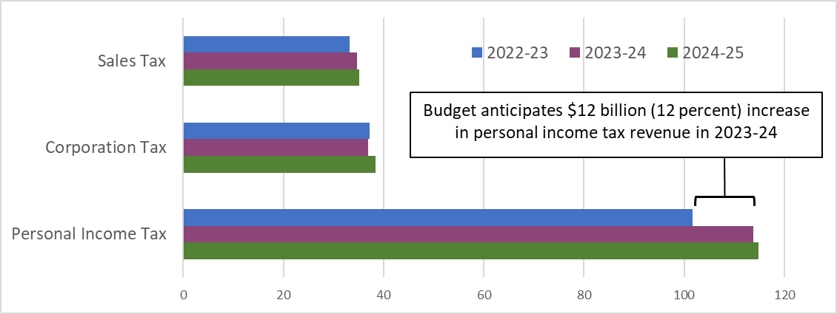
Budget Assumes Relatively Rapid Rebound, Especially in Personal Income Tax
Revenue Estimates, in Billions

Slide 8
January Tax Collections Well Below Estimates
In Billions
 |  |  | Difference
 | Governor’s Budget Estimate | Actual Collections | Amount | Percent
Personal income tax | $20.4 | $15.4 | -$5.0 | -24.5%
Corporation tax | 2.2 | 2.2 | -0.0 | -0.1
Sales tax | 1.9 | 1.8 | -0.1 | -2.9
Total “Big Three” Taxes | $24.5 | $19.4 | $5.1 | -20.8%

Slide 9
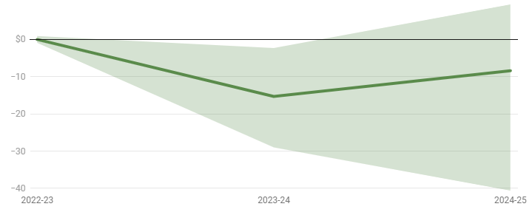
LAO Revenue Estimates: $15.3 Billion Lower in 2023-24 and $8.4 Billion Lower in 2024-25
LAO February Forecast Minus Governor's Budget (in Billions)

Slide 10
The State Economy

Slide 11
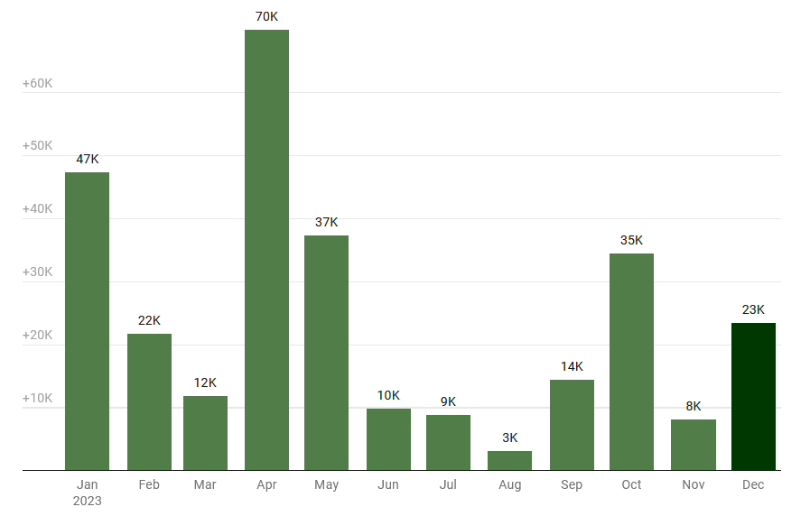
State Economy Is Adding Jobs…
Monthly Jobs Added in California

Slide 12
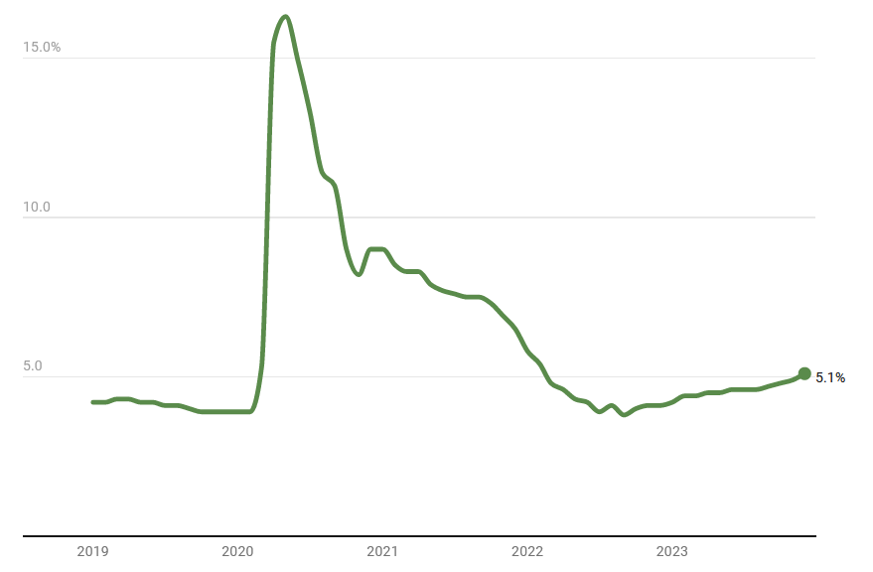
… But State Unemployment Rate Still Rising

Slide 13
Many Indicators That Are Important for State Revenues Remain Depressed
Less Private Investment in Business Startup and Expansion
Fewer California Companies Going Public
Key Sectors—Especially Tech—Remain Depressed
Weakness in These Indicators Linked in Part to Federal Decisions About Interest Rates
The sectors of the state economy that drive state revenues are very sensitive to increases in interest rates.
California revenues more reliant on these sectors than other states.

Slide 14
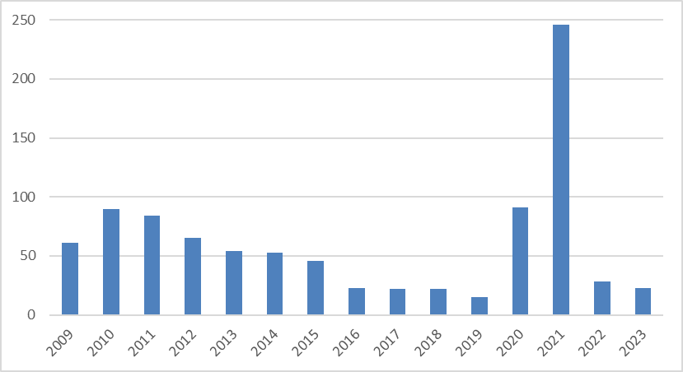
Example: Fewer California Companies Going Public
Initial Public Offerings (IPOs) by California Companies

Slide 15
School Funding Update

Slide 16
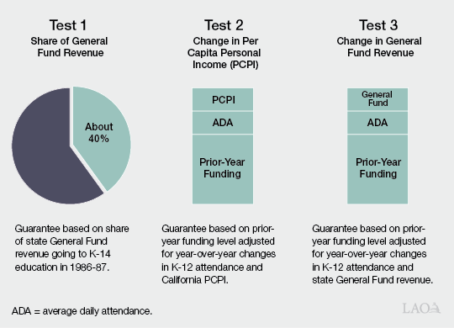
Proposition 98 Guarantee Determined by One of Three “Tests” in the Constitution

Slide 17
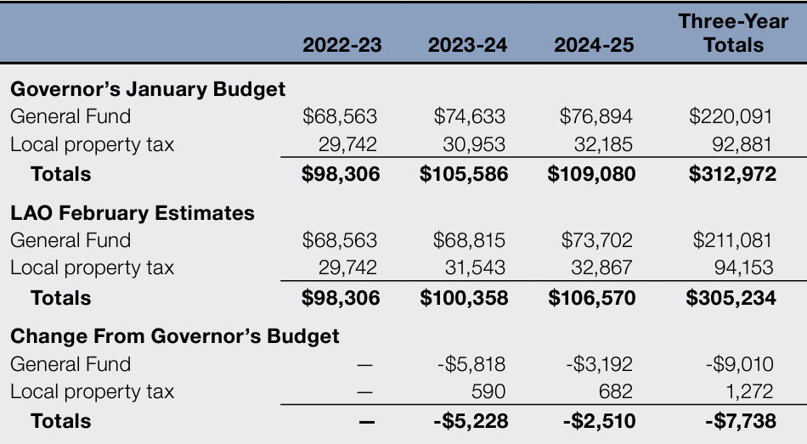
LAO Estimates of Guarantee $7.7 Billion Below Governor’s Budget Estimates
In Millions

Slide 18
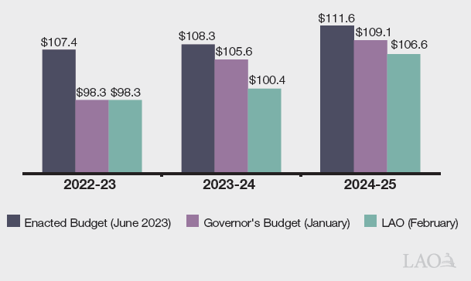
Significant Reductions in Proposition 98 Estimates Since Last June
In Billions

Slide 19
Governor’s K-12 Proposals

Slide 20
Governor’s Plan for Addressing Drop in the Prior Year
Governor Proposes New Type of Funding Shift That “Accrues” $8 Billion in Prior-Year Payments to Future Years
Schools would retain all funding they previously received in 2022-23.
The state would no longer recognize this funding as an expenditure on its books for 2022-23.
The state gradually would recognize the expenditure over a five-year period, beginning in 2025-26.

Slide 21
Governor’s Plan for Addressing Drop in the Current and Upcoming Year
$5.7 Billion Withdrawal From Proposition 98 Reserve
Discretionary withdrawal to cover existing program costs.
Proposal would leave $3.9 billion balance in Proposition 98 Reserve.
$1.2 Billion in Baseline LCFF Savings
Reflects savings from phaseout of pre-pandemic attendance levels in three-year average calculation.
Partially offset by additional attendance from transitional kindergarten.
Nearly $450 Million in Proposition 98 Preschool Savings

Slide 22
Governor’s Proposed K-12 Increases
Funds 0.76 Percent Cost-of-Living Adjustment (COLA)
Provides Second Round of Green School Bus Grants
Grants to replace older buses with battery-electric buses.
Budget provides $500 million on top of previous allocation.
Covers Higher Costs for Universal School Meals
Costs driven mainly by meal increase estimates and federal changes.
One-time backfill in 2023-24 and $122 million ongoing increase.
Funds Package of Staff Training and Technology Proposals

Slide 23
Assessing the Governor’s Budget

Slide 24
Positive Elements
Acknowledges Some School Funding Adjustments Likely Needed to Balance the State Budget
Introduces a Few Reasonable Ideas for Addressing the Reduction in Proposition 98 Funding
Discretionary withdrawal from the Proposition 98 Reserve (requires Governor and Legislature to agree on budget emergency).
Exploring potential savings in State Preschool Program.

Slide 25
Concerns
Estimates of Proposition 98 Funding Seem Too Optimistic
Funding for schools and community colleges likely $7.7 billion lower by the time the state adopts the budget in June.
Major Concerns With Cost Shift Maneuver
State is effectively borrowing from future revenues by creating a new type of binding obligation on itself.
Contributes to future state deficits—eventually the bill comes due.
Creates precedent for using maneuvers like this in the future.

Slide 26
Concerns, Cont.
New Spending Proposals Seem Unaffordable
During downturns, state typically tries to contain spending.
New K-12 spending proposals cost $1.4 billion.
Proposition 98 funding cannot even cover costs of existing programs.
State Relying on One-Time Funds for Ongoing Costs
June 2023 budget relied on nearly $1.6 billion in one-time funding to pay for ongoing costs in 2023-24.
Governor’s budget relies on $2.2 billion in one-time funds in 2024-25.
State Likely Needs Far More Reductions and Solutions

Slide 27
Addressing the Shortfall in K-12 Funding

Slide 28
Recommended Starting Point
Build Plan Prioritizing Core Programs and Budget Stability
Reject the Cost Shift From 2022-23 to Future Years
Use Reserve Withdrawal to Address the 2022-23 Shortfall
Reject New Spending Increases, Including the COLA
Begin Identifying Additional Reductions and Solutions Now

Slide 29
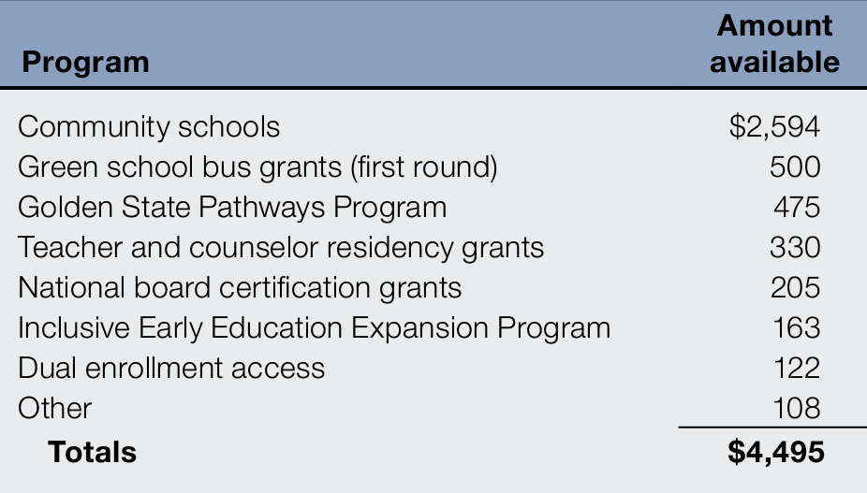
Additional LAO Solutions: Rescinding Some Unallocated Grants
Unallocated Grants as of January 2024, Estimates in Millions

Slide 30
Additional LAO Solutions: Revisiting Some Previous Program Increases
State Has Provided Significant Ongoing Increases to Five Major Programs
Expanded Learning Opportunities Program (after school activities).
Child nutrition (significant rate increase and universal school meals).
State Preschool.
School transportation.
Transitional kindergarten lower staffing ratios.
State Could Accomplish Core Objectives of These Programs in Less Costly Ways

Slide 31
Additional LAO Solutions: Other Spending Reductions
Make Temporary Reductions to Programs With Large Amounts of Unspent Carryover Funding
Pause New Grants Under Existing Programs
Reduce Some Historical Add-Ons
State provides nearly $1.3 billion to fund districts for programs they operated decades ago (but are no longer required to operate).
Scaling back these add-ons could reduce some disparities in district funding levels and provide ongoing savings.

Slide 32
The Universe of Other Solutions
Withdraw More Funding From the Proposition 98 Reserve?
Withdraw More Funding From Other State Reserves?
Defer Payments to Schools?
Tax and Revenue Options?
Provide Funding Beyond Proposition 98 Minimum?
Very challenging when state budget overall faces $58 billion deficit.
Under our latest revenue estimates, overall deficit is $73 billion.

Slide 33
The Bottom Line
State and Schools Facing Tight Fiscal Times
The parts of the state economy that drive tax revenues are weak.
The state is facing shortfall over next several years, not just this year.
Making Some Difficult Decisions Now Would:
Help the Legislature preserve its core K-12 priorities.
Stabilize the budget.
Set up better choices next year.
Recommend Using the Coming Months to Explore Solutions, Develop Alternatives, and Assess Trade-Offs

